Slide 1
Face-Recognition Attendance System
PRESENTATION By : HARSHIT SAINI
University Roll no. : 1918367
Class Roll No. : 22
Section : K
Branch : CSE

Slide 2
Introduction
A Face Recognition Attendance System is a technology capable of matching a human face from a digital image or a video frame against a database of faces, typically employed to authenticate users through ID verification services, works by pinpointing and measuring facial features from a given image. The programming language used is Python.
Python is an interpreted high-level general-purpose programming language. Its design philosophy emphasizes code readability with its use of significant indentation. Its language constructs as well as its object-oriented approach aim to help programmers write clear, logical code for small and large-scale projects.

Slide 3
Project Requirements
Code Editor: VSCode
Python Libraries: Tkinter, OpenCV
Algorithm used: haarcascade_frontalface_default, Local Binary Pattern Histogram(LBPH)
Database Software: Xampp

Slide 4
Major Steps to Implement Face Recognition
Creating a database to store the student details and photos.
Training the data with the LBPH algorithm.
Detecting the face of student in camera.
Recording the attendance of student in real time.

Slide 5
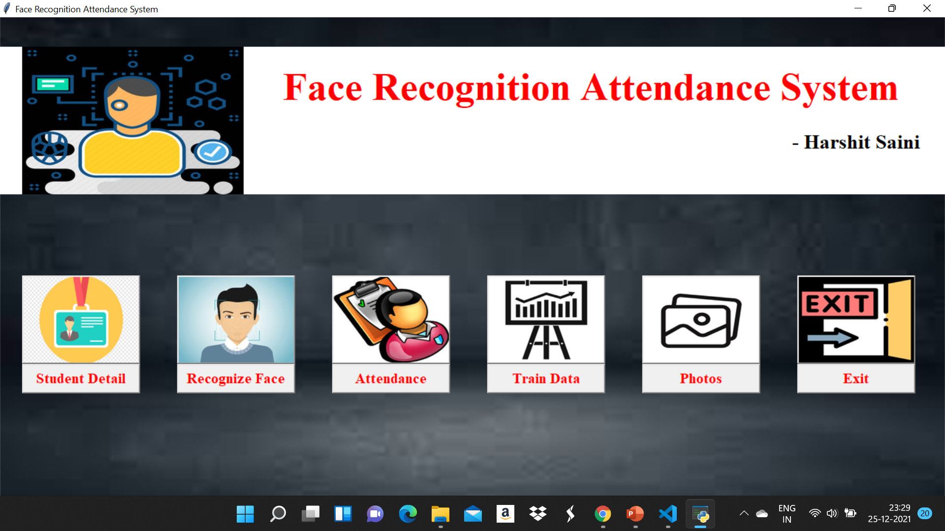
Result Analysis
Home Page

Slide 6
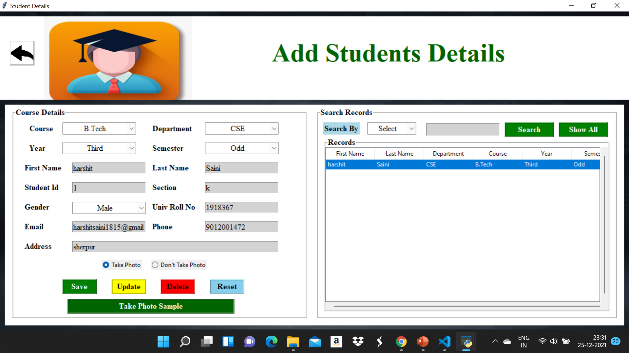
Student Information

Slide 7

Train image

Slide 8

Face Detection

Slide 9
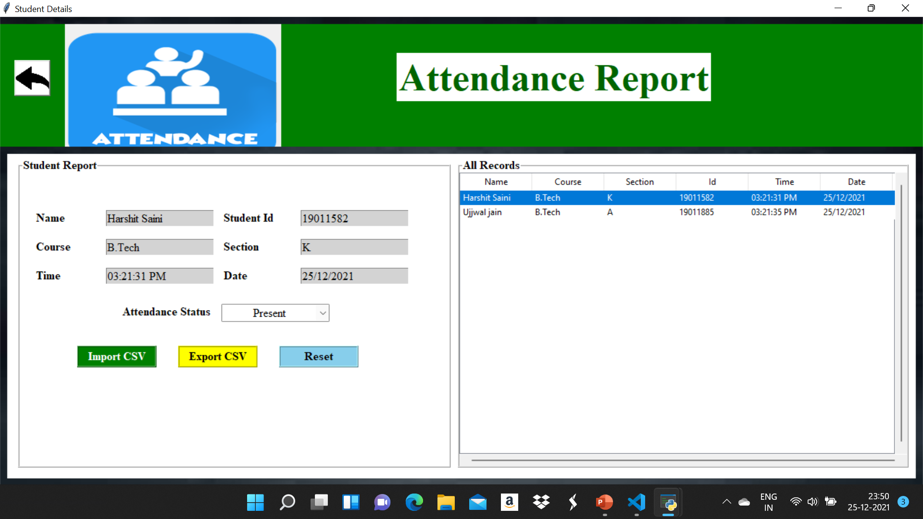
Attendance

Slide 10
References
Ahonen, Timo, Abdenour Hadid, and Matti Pietikainen. “Face description with local binary patterns: Application to face recognition.” IEEE transactions on pattern analysis and machine intelligence 28.12 (2006): 2037–2041.
T. Kanade, Computer Recognition of Human Faces. Basel and Stuttgart: Birkhauser Verlag 1997.
Shubhobrata Bhattacharya, Gowtham Sandeep Nainala, Prosenjit Das and Aurobinda Routray, Smart Attendance Monitoring System : A Face Recognition based Attendance System for Classroom Environment, 2018 IEEE 18th International Conference on Advanced Learning Technologies, pages 358-360,2018.
Abhishek Jha, "Class room attendance system using facial recognition system", The International Journal of Mathematics, Science, Technology and Management (ISSN : 2319-8125) Volume: 2,Issue: 3,2014

